Slide 1
Theories of Entrepreneurship
X-Efficiency Theory
Theory of Profit
High Achievement Theory
Theory of Social change
Theory of Innovation

Slide 2
List of Propunder
S.no | Theory | Propounder
1 | X-Efficiency Theory | Leibenstein
2 | Theory of social change | Max weber
3 | Theory of profit | Knight
4 | Theory of High Achievement | David McClelland
5 | Innovation Theory | Schumpeter

Slide 3
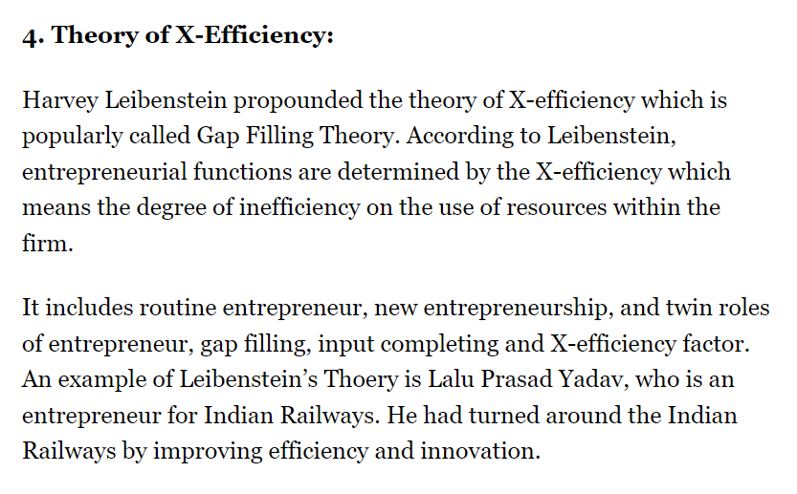
X- Efficiency theory

Slide 4
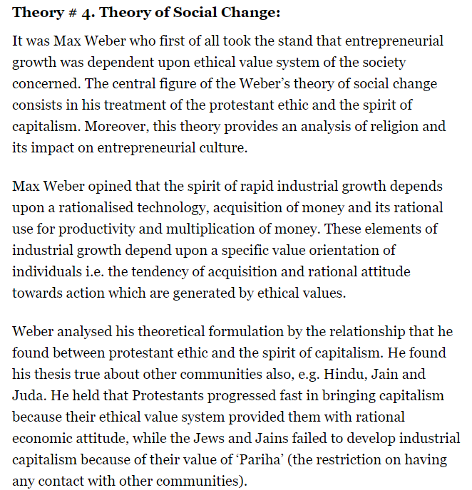
Theory of Social change

Slide 5
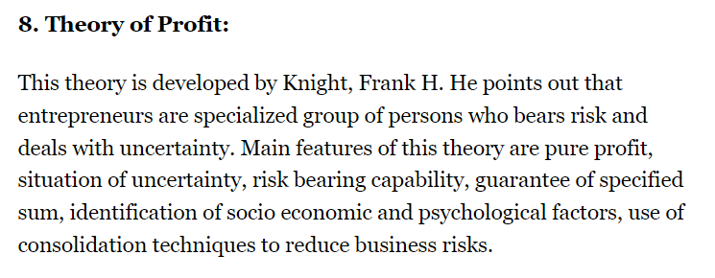
Theory of Profit.

Slide 6
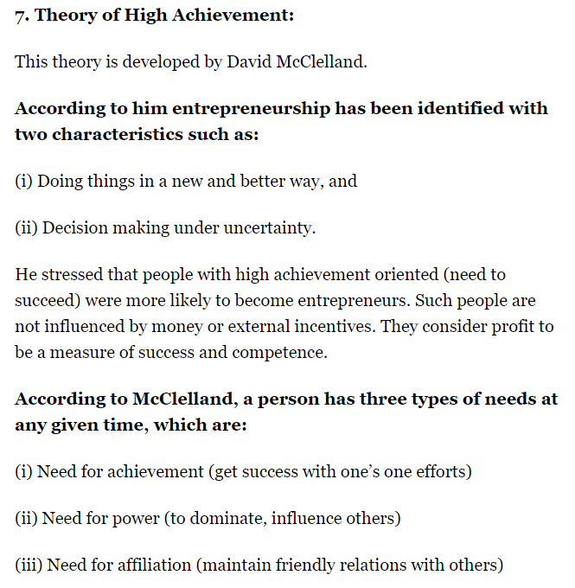
Theory of High Acheivement.

Slide 7
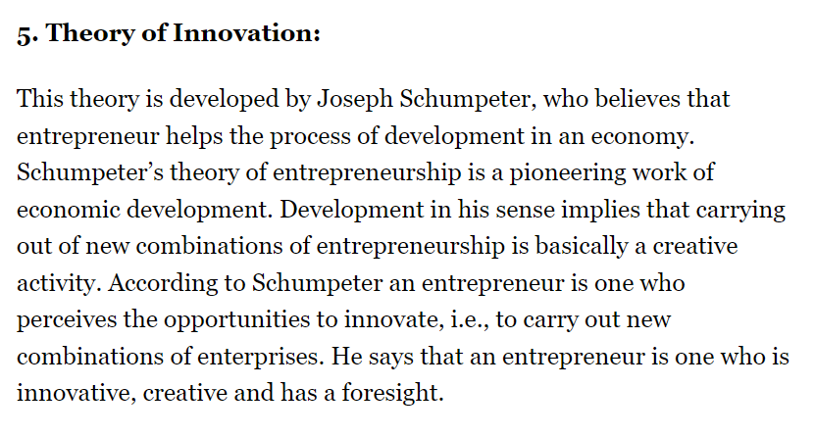
Innovation Theory

Slide 8
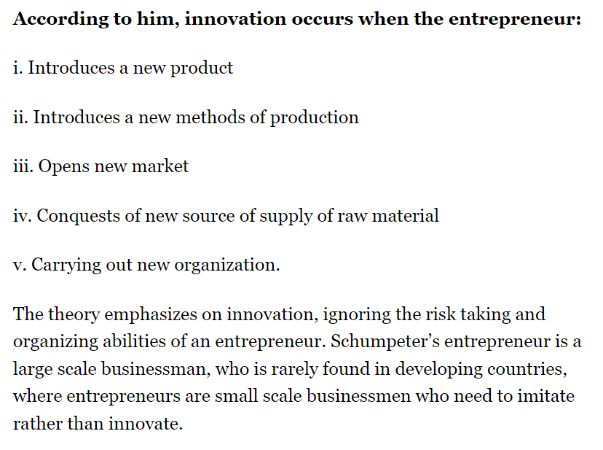
Conditions for Innovations

Slide 9
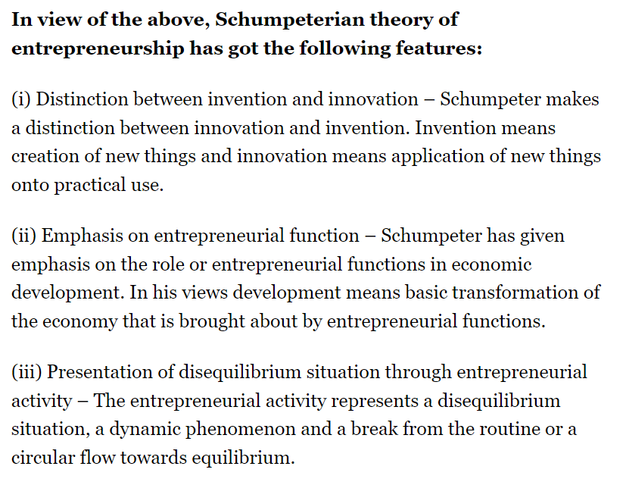
Difference Between Invention and Innovation

